Slide 1


Back to School Parent Meeting
CTA
¸Ä¢போர்னியா தமிúì கழ¸õ

Slide 2
Agenda
CTA’s Goal and Objectives
CTA History
CTA Board and Structure
CTA’s Polices
School Year Calendar
Curriculum and Syllabus
School Fee
Handbook
Teaching Guidelines
Parent’s responsibility
Student’s responsibility
Performance evaluation
TVU (Tamil Virtual University)
Communications
Fun activities
Annual day
Website
Our Dream
Q&A

Slide 3
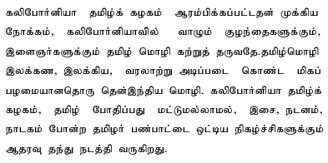
CTA’s Goal
Mission
California Tamil Academy (CTA) was conceived with the primary objective of teaching Tamil, an ancient South Indian Language with a very long history and rich literature to the children and young adults living in California. As an extension to the teaching of Tamil, CTA also supports cultural activities such as Music, Dance, Drama and any art form based on Tamil language and Tamil culture.

Slide 4
CTA’s Vision
Develop a love for learning Tamil that will last a lifetime (intellectual, physical and emotional)
Develop communication skills in Tamil so they can appreciate family values and feel the binding
Develop self-esteem and pride by participating in school / community activities
Provide an identity to our younger generation
Preserving cultural identity and heritage to maintain essential family values
Make the children to feel, internalize and self-convince about the value of Tamil – remove the question of why should I learn Tamil?

Slide 5
CTA’s Objectives - Cont’d
CTA strives to provide "Commitment to Excellence" in teaching Tamil
Provide a kid friendly environment for students to learn Tamil for a minimum of 10 to 12 consecutive years
Dedicated Staff
  Provide the best possible educational program in Tamil
  Provide an environment that motivates each child to learn and excel in the language

Slide 6
CTA’s History
Started in 1998 as a home school with 13 students in the kitchen of an enthusiastic parent who wished to keep her children in touch with their Mother Tongue and cultural heritage
Today’s California Tamil Academy was founded with the help of 4 Parent Volunteer Teachers and has grown to a strength of more than 150 teachers and officers in 2006

Slide 7
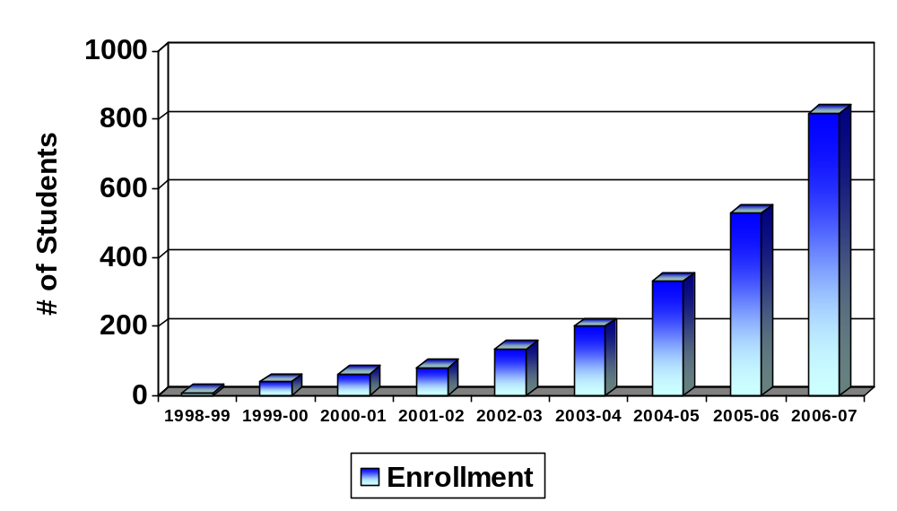
CTA’s Growth in 8 years

Slide 8
CTA Board and Structure
Non-profit organization: Run by more than 200 dedicated Volunteers.
NO one gets paid
Board Members
Board Position | Member Name
President | Vetriselvi Rajamanickkam
Co-President | Kumar Kumarappan
Vice President | Vidya Velchamy
Secretary | Senthil Sathasivam
Treasurer | Meena Annamalai
Cupertino Principal | Vidya Velchamy
Fremont Principal | A.Nallappan
Evergreen San Jose Principal | Thillai Kumaran
Pleasanton Principal | A.Manickam
Curriculum Committee:
Vetriselvi Rajamanickam
Latha Chandramohan
Srividya Narayanan
Kandasamy Palanisamy
Syllabus and Question papers committee:
  Meena Nallakumar
  Kavitha Senthil

Slide 9
CTA Board and Structure – Cont’d
Cultural Secretary:
Pallavi Saravanan
CTA Website:
Kumar Kumarappan
Kannan Muthukaruppan
Ganesan Arunachalam
E.K. Senthil and his team from Zaxis Ltd, Chennai
Branches:
Two new branches added this year
Evergreen San Jose and
Pleasanton
Branch Name | Year started | Current Strength
Cupertino | 1998 | 393
Fremont | 2004 | 254
Evergreen – San Jose | 2006 | 71
Pleasanton | 2006 | 100

Slide 10
CTA’s Policies
Non-discriminatory Policy
CTA does not discriminate on age, gender, race, religion, physically handicapped or country of origin
Well-defined, age and grade appropriate syllabus & skills
Low student to teacher ratio (from 8:1 to 10:1)
  Students are made to feel comfortable working at their proper pace
Trust & Care
  Work towards a feeling of personal value for each student, parent, and staff member
Learn Tamil with Fun

Slide 11
School Year - Calendar
First Term | Sep to Nov | 11 working days
Second Term | Dec to Feb | 11 working days
Third Term | March to May | 11 working days
Detailed Calendar is available at http://catamilacademy.org/schedule.htm
Total Working Days - 33 (including Tests and Annual day)
Holidays – 5
  Labor Day – Sep 3 , 2006
  Thanks Giving Day - Nov 26
  Christmas – Dec 24th , 2006
  New Year – Dec 31st , 2006
  Spring Break – Apr 8th, 2007
Quizzes / Tests – 3
  First Tem Test – Nov 19th , 2006
  Second Term Test – Feb 25^{t}h , 2007
  Final Exam – May 13th , 2007
Graduation Day – May 19th , 2007
Annual Day – May 20th , 2007
CTA Summer Vacation - May 27th to Aug’ 07
Every year the number of working days changes

Slide 12
Curriculum and Syllabus
Collaboration and feedback – the main sources of input to the committee
Teachers
Students
Syllabus and Exam
Committee
Book/Curriculum
Committee

Slide 13
Curriculum and Syllabus
Constantly improving syllabus
  Composed through constant self evaluation
  Incorporate regular feedback from students, teachers, testing committee and parents
Teaching Materials
  Printed our own book sets (reading, writing and exercise) for preschool 1, 2, Basic 1, 2, and 3
  Developed animated materials for the above syllabus - DVD
  Currently using text books recognized by the Government of Tamil Nadu, India for Grade 1 to 7
  Other appropriate materials from various sources on the Internet
Curriculum is designed with appropriate focus on reading, writing, and conversation for the students who live in US by the people who live in US

Slide 14
CTA School Fee
CTA is a Non Profit Organization
No one is paid by CTA except external accountant and auditors
Fee is collected to cover rent, insurance, school/office supplies, Annual day expenses (rent, gifts, medals, certificates), school magazine and miscellaneous
CTA charges a very nominal fee of $195/$180 for every student per year which includes the registration fees and book fees. This is the ONLY revenue for the school.
Every student needs to pay the Tuition and Book Fees at the time of registration. Tuition fee for all the three terms is $180.00/$195.00 which includes ONE set of books needed for the school year. Books are handed out to the student on the first day of the school or upon joining CTA which ever is later. A late fee of $15 will be charged if the entire tuition fee ($180.00/$195.00) is NOT paid on or before the end of November. Tuition fee can either be paid in one installment at the time of registration or in three installments.
We collect the entire school fee for all three terms (Fall, Winter and Spring) in advance before the end of first term
Method of Payment: Credit card is accepted when paid online. Checks are accepted at CTA. Cash is NOT accepted

Slide 15
CTA School Fee – Cont’d
Refund Policy: Withdraw before school starts, $20.00 service charge
Withdrawal within 4 weeks after school starts, refund 80% tuition.
Withdrawal before second term, refund 50% tuition
Withdrawal after second term, there is NO refund.
A written withdraw request (email) must be submitted to the school principal in order to get the refund. No refund will be processed without the written request
CTA will be sending you reminders, if you have dues
Teachers do have this information and they also will request you to make the payments if there is a due
if they had been issued books, they should return it. Or they will be charged for the books

Slide 16
Hand Book
Every student (except preschoolers) received a CTA 2006-2007 hand book - (Tamil Homework Assignment Book)
Has the school calendar, important dates, responsibilities and, quiz/exam dates
CTA rules and regulations
Parent commitment
Tamil Letter table
Pages for the teacher/student to make notes about the home work for the following week
Pouch to hold the syllabus
Review the hand book regularly every week
This may also be used as a communication vehicle by the class teacher to communicate to the parents
Request your children to maintain this properly
Good offline source to know all about CTA

Slide 17
Teaching Guidelines
NO punishment, NO imposition
Positive reinforcement
Treat students with respect
Trust and care students and parents
NO comparison with other kids
Understand and accept that there are many variations of Tamil
Teach ONLY the formal Tamil, set by CTA’s syllabus committee
Be consistent with all students
Be fair and friendly to kids and parents
Aim is to have the kid to come to school for many years
It’s NOT meant to be a competitive learning environment
It must be an enjoyable experience for all - teachers, students and parents
It’s a journey to experience and NOT a race to win

Slide 18
Parent’s Responsibility
Ensure that your child is regular and on time for class and special CTA events
Take personal interest in what your child is learning in the class and encourage the child to practice the same at home
Ensure that your child completes the homework before the next class
Encourage your child to use (or) practice Tamil at home or whenever/wherever possible. Make them feel proud
Cooperate fully with the teachers whenever they provide feedback pertaining to your child
Attend meetings and special events arranged by the CTA, including parent-teachers group meetings and One-on-One parent-teacher meetings.
CTA exclusively depends on the support and commitment of parent-volunteers to run the school efficiently and successfully.
We request you to spare some of your time to make our school the BEST. We kindly request you to participate in school activities as much as possible

Slide 19
Student’s Responsibility
Excellent behavior is expected of all California Tamil Academy students
Students need to bring notebook, books, binder (if needed), pens, pencils and other materials necessary to the class every week
Participate in class, listen well, and take part in class discussion
Ask questions if you do not understand the discussion
Understand and record your assignments before leaving the class.
Cooperate with other students and teachers
Do your homework every week without fail
Practice the class work at home - Minimum two times a week.
Read, write, converse in Tamil whenever and where ever possible.
In the classroom:
  Treat others with respect and dignity
  Don't disturb or distract others
  Be on time to class
  Hats need to be removed inside the buildings
  Do not bring toys and other personal items to the classroom

Slide 20
Punctuality and Absence Policy
We expect all students to be in the classroom no later than 10:05 AM
Class room doors will be closed at 10:05 AM
Attendance officer will visit the classes between 10:05 and 10:10 and will mark absent if student is not present and the teacher doesn’t have any information on the whereabouts.
Please make all efforts to come to Tamil school on time which is 10:00 AM
Perfect Attendance: All students with 100% perfect attendance – Physically attending the classes at CTA on all 33 Sundays - are honored with a trophy award at the end of the school year. Missing one or more classes for any reason will automatically disqualify to receive the perfect attendance award. Students who joined late do not qualify for this award
There is no excused or unexcused leave. All leaves are considered as absence
The student/parent should inform the teachers about their absence and be prepared for the next class by reviewing the missed class work before the next class

Slide 21
Homework
Learning Tamil in the CTA classroom for 90 minutes is NOT enough for a student to learn Tamil
Homework is a key piece of CTA curriculum
It not only reinforces what they learnt at CTA but also makes the family to get involved and siblings to get motivated
Homework is clearly marked in the syllabus for every week. Please refer the syllabus for every week’s HW. Hardcopy of the syllabus has been handed over to all students
Teachers are requested to review the next week HW in the class during the last 10 minutes
Homework is designed to take only 30 minutes to 45 minutes per week
Don’t you love to hear your kids reading Tamil, singing Tamil songs, writing Tamil and conversing in Tamil at home?

Slide 22
Weekly Student Assessment
Teachers assess students every week. Its an ongoing process
Teachers fill out the weekly Student Assessment Form for every student in their log books
They track Attendance, Home Work, Reading &Comprehension, Writing, Participation, Conversation, Book Report, Grammar, and Quiz/Test in the weekly assessment sheet as applicable for the week
This serves as a supporting information for the student’s term/final evaluation and parent-teacher one-on-one conference

Slide 23
Term Progress Report
At the end of each semester, teachers issue a report card to the students about their progress in the class.
This report has a standard format like the one you get from the regular schools
Teachers will arrange a one-on-one conference with the parents to go over the progress report and address any concerns parents may have
Parents may contact their child's teacher at any time to discuss student’s progress. If necessary, a student teacher meeting can be scheduled to look more closely at your child's progress and set goals to promote achievement
Preschoolers and conversation class do NOT have a term report

Slide 24
Final Evaluation and Ranking
Every student will receive an annual progress report excluding Preschool and Conversation class
This is the final evaluation for the school year and reflects the Year-round Evaluation of student’s skills and knowledge
Student’s weekly assessment will be used at the end of the year, along with the student’s term test scores and final exam score, to calculate the year-round performance of the student
Students are NOT ranked
Basic I to Grade 4 students will receive letter grades. A: 90 to 100, B: 80 to 89, C: 70 to 79, and D: 60 to 69
Informal progress report is issued to Pre-Schoolers and conversation students with NO grades

Slide 25
Drop Off and Pick Up
Parents are fully responsible for dropping off the kids to the appropriate classroom and pick them up ON TIME. Pre-schoolers need to be signed in. Don’t be late
CTA is NOT responsible for any untoward behavior/activities from both kids and parents that affect the general atmosphere of the premises where the classes are held in
CTA will NOT be responsible for the kids and their whereabouts beyond the duration of the class timing which is 10 AM to 11.30 AM.
Each parent is responsible to follow the parking rules of the premises where the classes are held.
CTA is not responsible for any parking violations
Request kids not go out of the classrooms on their own. Also ask them NOT to wander in the parking lot on their own
Preschool I & 2 kids will NOT be let go on their own. Need to be picked up from their respective rooms by signing out

Slide 26
TVU (Tamil Virtual University)
Run by Tamil Nadu Government. www.tamilvu.org
CTA is a Franchisee of TVU
Offers 3 levels. Beginners,Intermediate and Advanced
We will be preparing the kids for these exams and the information will be put up in the notice board and sent through emails.
After clearing exams – Certificates are provided by TVU.
Kandasamy Palanisamy is the coordinator for TVU.
If interested please contact their branch TVU Branch coordinators
Grade 1 and above are eligible for Basic level
Students who passed Basic level are eligible for Intermediate level
Students who passed Intermediate level are eligible for Advance level
Classes held from mid October to February every Sunday from 11.30 to 12.00
No charges for the class
TVU Exam fee of $12 must be paid by the student

Slide 27
Communications
Email is the main mode of communication
Weekly email update from principal to all parents
Weekly email update from vice principal to all teachers
Email from preschool 1 & 2 class teachers to preschool parents about class activities
Teachers to parents email for all other grades is on need basis
Website
Teachers and principal/vice principal are the main contacts and source of information for parents
We try hard to limit the number of emails sent from CTA
Please make it a point to read CTA emails regularly and keep your email addresses updated in CTA website

Slide 28
Fun activities
Deepavali
Halloween Parade
Santa’s Visit (Christmas)
Picture Day
Pongal
Tamil New Year
Year Book
Graduation Ceremony
Annual Day

Slide 29
Annual Day
Great event celebrated every year towards the end of the school year
It will be a BIG CTA (combined) event including all Branches
Almost every kid participates in the celebrations by participating in one of the events
Teachers and volunteers start the preparation in Feb/March
All performances are based on Tamil – Dance, Song, Skit, Play, recital, etc.
All Preschoolers participate in a group class event
If you are interested in coordinating an event, have an idea, etc, please volunteer for the Annual day. We need more event planners/coordinators
No admission charges
CTA also hands out the school magazine at this time. Every kid contributes to the school magazine.
Class photo with teacher will be part of the magazine.
If you haven’t picked up the last year magazine, stop by CTA office

Slide 30
Web Site
Our website is http://catamilacademy.org
Thanks to ZAxis of India for maintaining the website and also thanks to volunteers Kumar, Kannan, EK Senthil and Ganesan for actively managing the website
Lot more functionalities have been added during last year to manage student information online
Currently focusing on improving the stability of the website
Parents can view/modify their profile, view their child information, syllabus, teacher information etc. on the website
Please keep your email updated. This is the primary means of communication
Our intention is to be efficient using technology. Yet it may take time for all the teachers to fully utilize the online tools
Teachers have started recording the weekly progress and term reports online.
Attendance is also maintained online
Information on Tamil Computing – to read and type Tamil using your computer – has been loaded to the website under resources Old_2004-2005 \ Teaching_Resources \ Tamil_Computing
Your personal information is well protected

Slide 31
Our Dream…..
Develop and print our own CTA books for Grade 1 through 5 in next two to three years
Develop animated contents for Grade 1 and above
Enhance and evolve Tamil teaching by taking advantage of computers and internet
Have the children to learn Tamil through structured program for a minimum of 10 years - from age 3 to 13 - Preschool to Grade 5
Have the teenagers to be associated with CTA between ages 13 and 18 through informal programs like clubs, Tamil computing and volunteering
Have them to get involved in CTA operations - Prepare them to take over CTA for their children
Get more recognition and awareness for Tamil in public schools where our children go to
Help children who attended CTA to get credits towards language for having learnt Tamil at CTA in their high school (20 units or so) wherever possible
Franchise CTA outside of Bay Area
Make every child from a family of Tamil origin born in US to attend CTA
Make future generations of people of Tamil origin in US, converse in Tamil with confidence and pride with their family and Tamil speaking friends
CTA celebrates it’s silver Jubilee – only 18 years left!
Help us to make our dreams real

Slide 32
¿ýÈ¢
Thank You for your overwhelming support
It has been a pleasure to teach – TAMIL - to (y)our children
Please continue your support
Thanks for your cooperation, understanding and support
Thanks for your time

